Slide 1


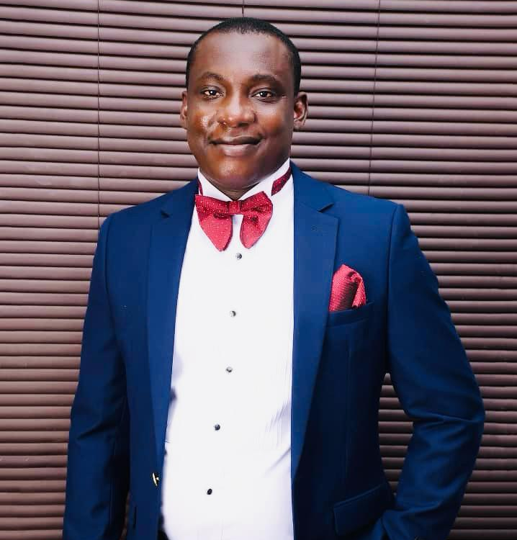
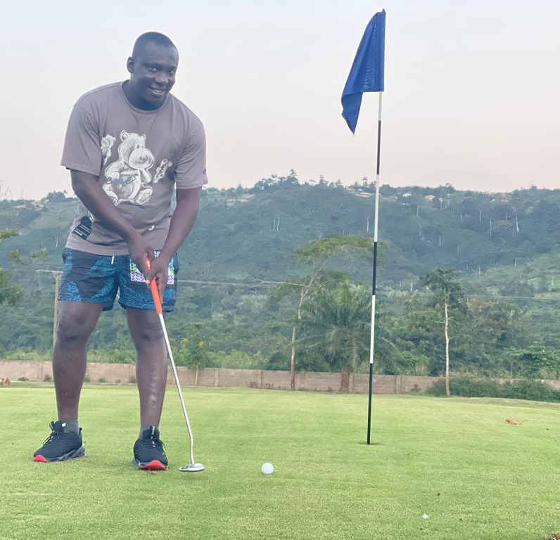
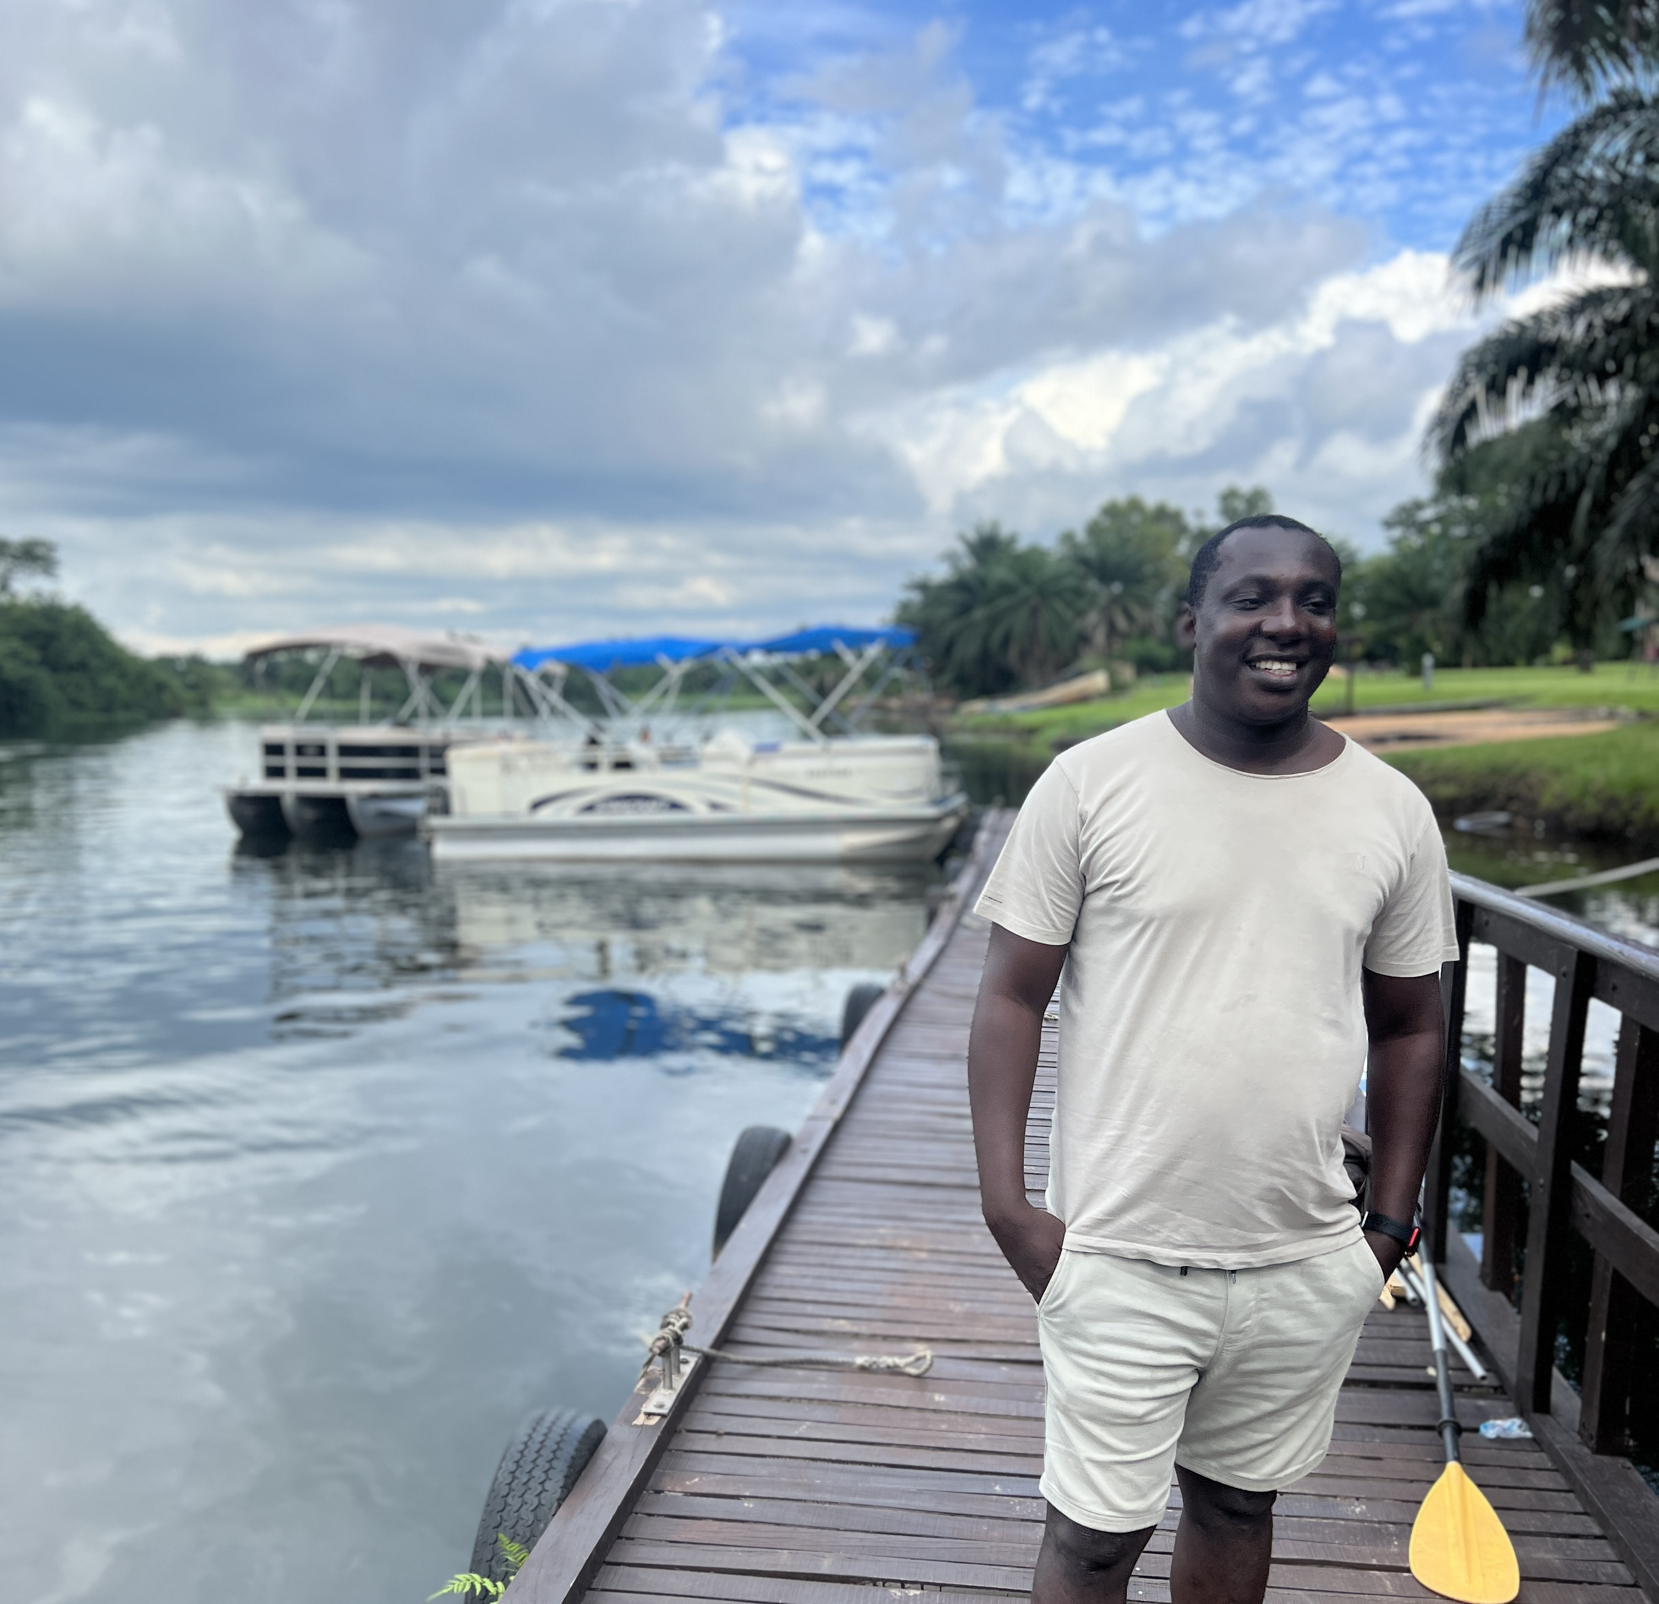
Getting to Know Me
Work
Personal
Sustainability Coordinator
Significant others / family members / furry friends in my life
Simon, Aikins, Mashal & Alex
Seven years
How I enjoy spending my free time
Reading,adventurous & bonding with family and friends
Tagro Eco-Louisbolk Institute, Cocoa Merchants Gh. Ltd
My favorite / comfort food
Fufu & Ampesi
Progressive career development
My favorite song
‘See Them A Come” Joseph Hills
William Kyeremeh
‘ William ’
Calm, Observant, analytic, adventurous and open to learning
This is me outside work, doing stuff I enjoy in my life …

